Slide 1

1. Systems, Science, and Study

Slide 2
Learning Objectives
Know definitions of the terms used throughout the book, including geographic information (GI)
Be familiar with a brief history of GI technology
Recognize the sometimes invisible roles of GI in everyday life, business, and government
Understand the significance of GI science, and how it relates to GI systems
Understand the many impacts GI technologies and their underpinning science are having on society and the need to study those impacts.

Slide 3
Outline
Introduction: What are GI science and systems and why do they matter?
Data, information, knowledge, evidence, wisdom
GI science and systems (GISS)
The technology of problem-solving
The disciplinary setting of GISS
GI science and spatial thinking
GI systems and science in society

Slide 4
What is a Geographic Information System?
Geographic – relates to a specific place on or in relation to the Earth’s surface
Information – is data to which some value or interpretation has been added. In GI, the information relates to measurements, maps, images, sounds etc. of the Earth’s surface
Systems – a system designed to perform a wide range of functions on and with GI

Slide 5
The Importance of Location
Geographic location is an important attribute of activities, policies, strategies, and plans.
Geographic problems involve an aspect of location, either in the information used to solve them, or in the solutions themselves

Slide 6
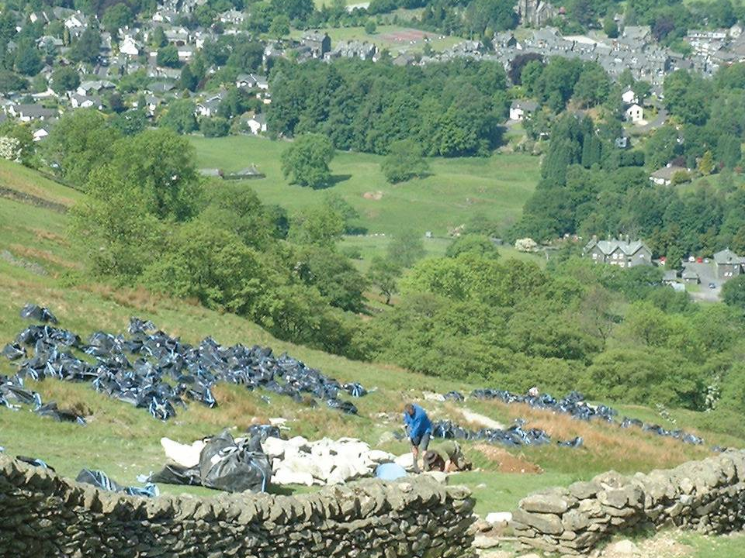
The Importance of Location

Slide 7
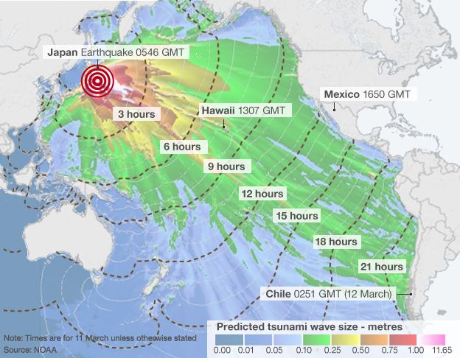
The Importance of Location
Tōhoku earthquake and tsunami
GI science and systems are integral to response and recovery
Source: NOAA

Slide 8
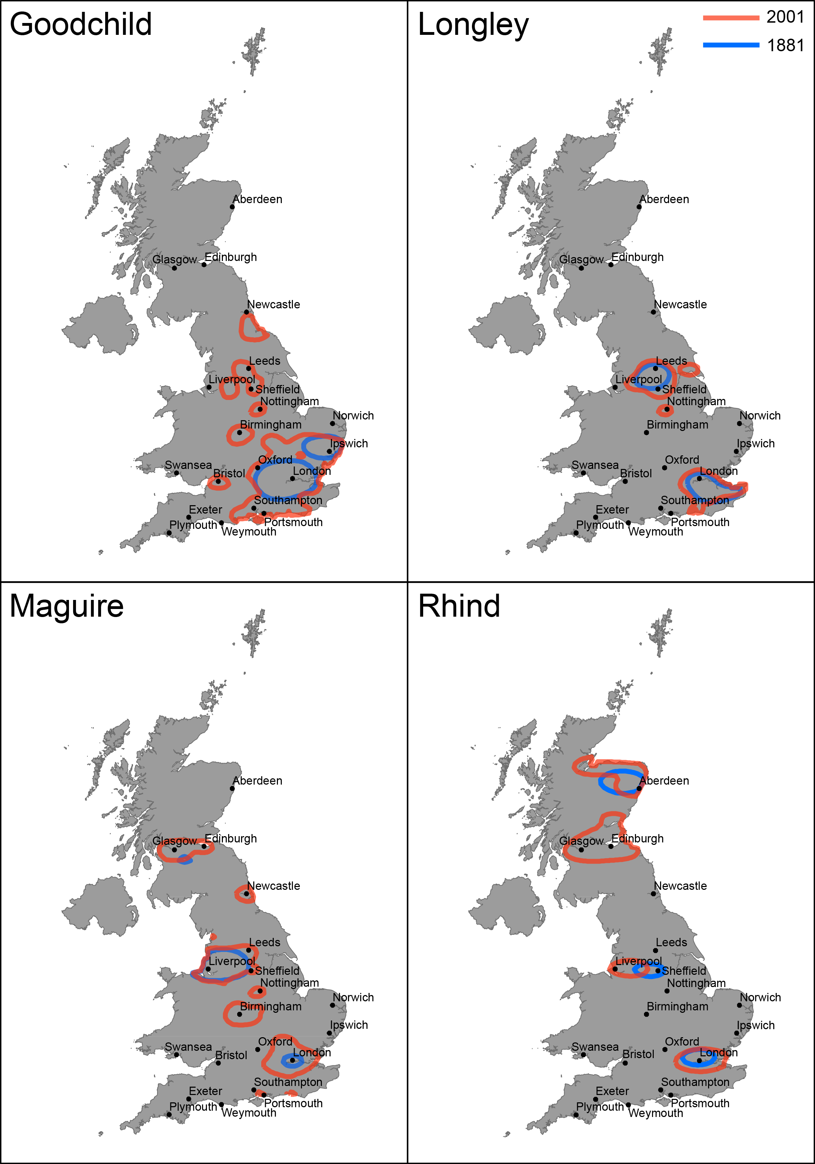
The Importance of Location
Researching family histories and geo-genealogy illustrates curiosity-driven research
Courtesy: James Cheshire

Slide 9
Spatial is Special
Geographic: the Earth's surface and near-surface
Spatial: any space (not just the space of the Earth's surface)
Spatial Analysis: application of techniques (in GI technology) to geographic and non-geographic spaces
Geospatial: (subset of spatial, applied specifically to the Earth's surface and near-surface)

Slide 10
Spatial is Special
Why is spatial special? (Industry, hundreds of courses, millions pounds etc.)
almost all human activities and decisions involve an important geographic component
Crucial to understanding both physical and human geography
working with geographic information involves unique, complex and difficult choices
For example…

Slide 11
Decision-Making Support Infrastructure
Data
Information
Evidence
Knowledge
Wisdom
Ease of Sharing
Easy
Easy
Often not
Easy
Difficult
Impossible

Slide 12
Decision-Making Support Infrastructure
Data
Information
Evidence
Knowledge
Wisdom
Raw geographic facts
Contents of a database assembled from raw facts
Results of analysis of many datasets or scenarios
Personal knowledge about places and issues
Policies developed and accepted by stakeholders

Slide 13
Example…
Data
Information
Evidence
Knowledge
Wisdom
Names and Addresses in worldwide telephone directories
Raw names cleaned, geocoded, and entered in a database
Results of analysis to examine flows of names across countries
Additional knowledge of “what looks right” based on previous experience
Develop migration policies based on knowledge generated from the system

Slide 14
What are Information Systems?
Knowledge is information to which value has been added by interpretation (particular context, experience, purpose)
Information becomes knowledge only when it has been read and understood

Slide 15
What are Information Systems?
Information systems help us to manage “what we know”…
organize and store
access and retrieve
manipulate and synthesize
apply to the solution of problems
Data are numbers or text (almost context-free)
raw geographic facts
e.g., a temperature at a given location
transmitted as a stream of bits
Binary – 1,0

Slide 16
What are Information Systems?
Information has multiple definitions
Narrow…
essentially synonymous with data
Broad…
Processed: anything which can be represented in digital form – but different from data as implies selection, organization, and preparation for purpose

Slide 17
Knowledge about how the world works is more valuable than knowledge about how it looks, because it can be used to predict

Slide 18
The Science of Problem-Solving
Form varies geographically, but processes can be very general
(landscapes vs. effects of burning fossil fuels)
Reflects traditions in academic geography:
idiographic focuses on the description of form and unique characteristics of places
nomothetic seeks to discover general processes

Slide 19

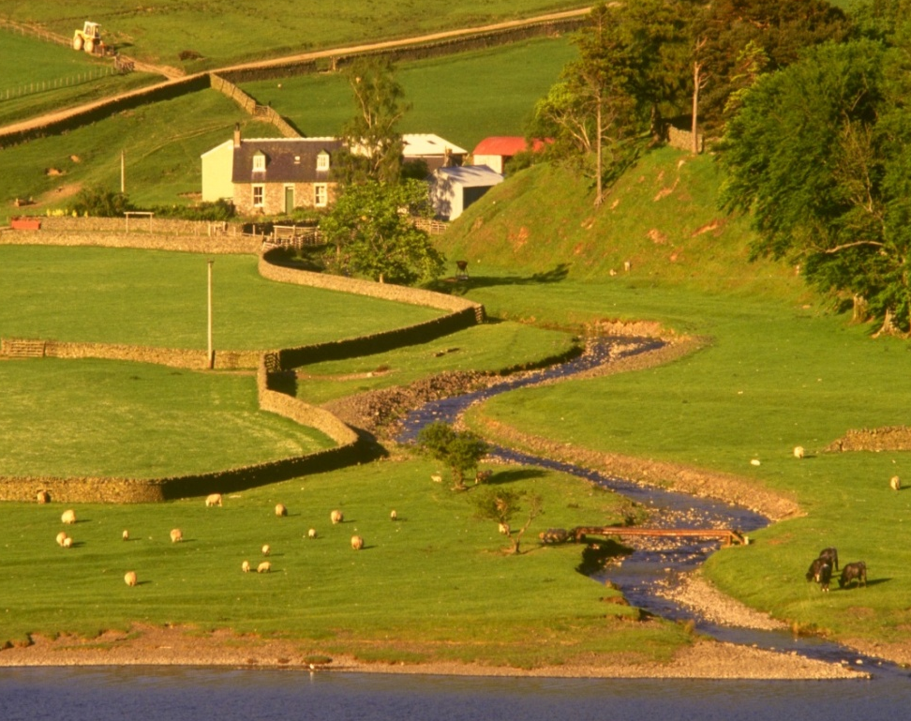
The Form of the Earth’s Surface Shows Enormous Variability (Idiographic)
Southwest USA
Northern England

Slide 20
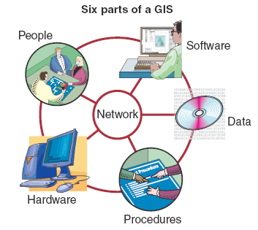
The 6 Components of a GI system
Hardware
Software
Network
Data
People
Procedures

Slide 21
The Technology of Problem Solving
GI technology is a combination of:
a software product, acquired to perform well-defined functions (GI software)
digital representations of aspects of world (GI)
a community of people who use these tools for various purposes (the GI community)
the activity of using GI systems to solve problems or advance science (‘doing GIS’)

Slide 22
The Disciplinary Setting of GI Science and Systems (GISS)

Slide 23
Brief History of GI Technology…
Mid 1960s - the first GI system was the Canada Geographic Information System
Mid 1960s computerized mapping system
Land-use management
Resource monitoring
Regulatory procedures
Late 1960s U.S. Bureau of the Census developed DIME (Dual Independent Map Encoding)
Digital records of all US streets, for automatic referencing and aggregation of census records

Slide 24
Brief History of GI Technology…
Early GI system developers recognized that the same basic needs were present in many different application areas, from resource management to the census
Harvard University – Laboratory for Computer Graphics and Spatial Analysis
Developed general-purpose GI system – 1970s ODYSSEY GIS

Slide 25
Brief History of GI Technology…
Separate needs of cartographers and mapping agencies
The quest to reduce the cost and time of map production
Computer support for map editing
Partial computerization of cartographic agencies by the late 1970s
Great Britain – first country with national digital map coverage (1995)

Slide 26
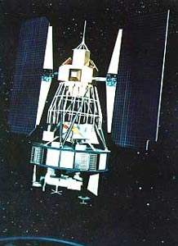
Brief History of GI Technology…
Role of remote sensing
military satellites of the 1950s → early 1970s civilian systems
military needs also developed the GPS
many technical developments originated in the Cold War
Landsat 2

Slide 27
Brief History of GI Technology…
Early 1980s take-off (hardware prices could sustain software industry) $250,000 computers and $100,000 software (large-scale resource managers)
The modern history of GI technology dates from the early 1980s, when the price of sufficiently powerful computers fell below a critical threshold

Slide 28
The Business Perspective
Includes
The software industry
The data industry
The GI services

Slide 29
Computer-Science and Information-Science Perspectives
Information science is a broad multidisciplinary area with a practical focus upon the collection, classification, manipulation, storage, retrieval, analysis, movement, and dissemination of information.
Raise questions of GI as a fundamental part of computer sciences, or class of applications

Slide 30
The Government Perspective
Public-sector information (PSI) is often expensive to initially produce, but then cheap to reproduce
Open Data – data which can be used, re-used, and re-distributed freely by anyone, subject only at most to the requirement to attribute and share-alike

Slide 31
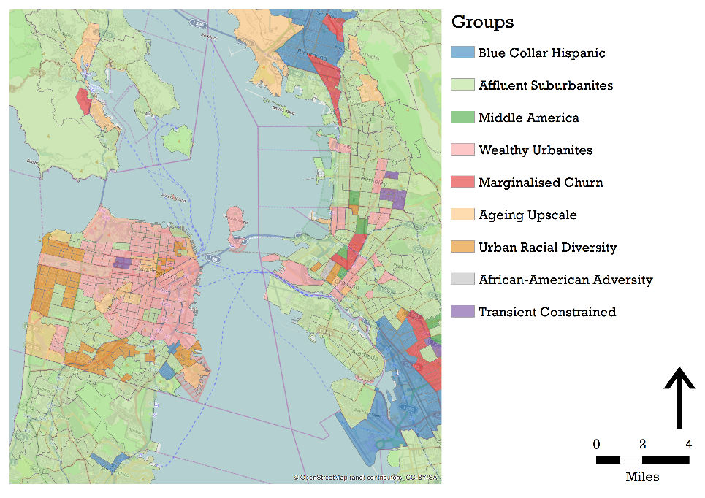
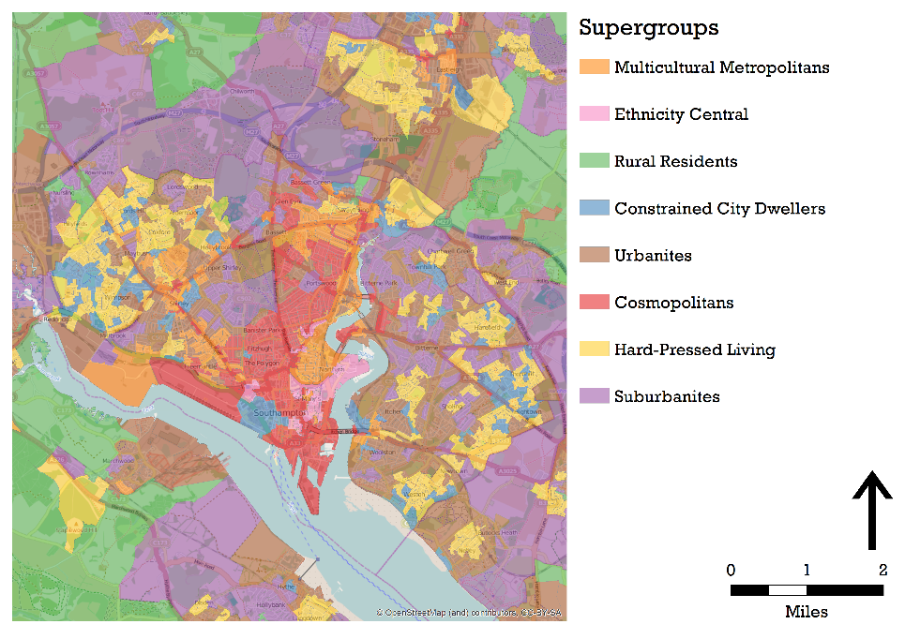
The Geography Perspective
Geodemographic neighborhood classifications make it possible to quantify how similar one place is to another, subject to the availability of consistent data across a jurisdiction.
A classification based on 2010 U.S. Census data, showing part of San Francisco
The UK 2011 Output Area Classifi cation, showing part of Southampton

Slide 32
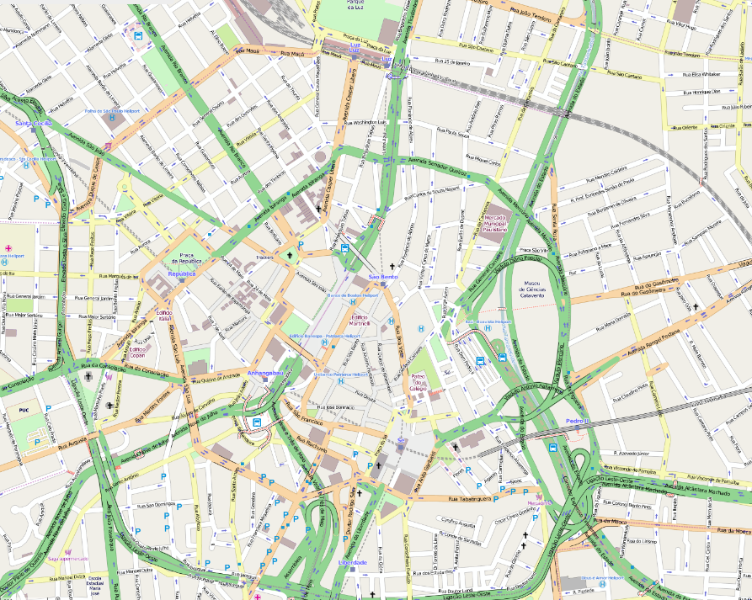
Neogeography
Neogeography to describe developments in Web mapping technology and spatial data infrastructures that have greatly enhanced our abilities to assemble, share, and interact with geographic information online.
Open-StreetMap is a free-to-use global map database which has been created through assimilation of digitized satellite photographs with GPS tracks supplied by volunteers
Source: OpenStreetMap

Slide 33
The Societal Perspective
Today we are rarely if ever cognizant that we are ‘doing GIS’
“Internet behemoths foist use of cookies on us users that betray our locations and many characteristics of our online identities, and we may resent the sophistication of the resulting advertising that is targeted upon us”
However, there is enduring unease in some academic quarters about GIS applications and their social implications, including
GIS favors certain phenomena and perspectives
Often used for purposes that may be ethically questionable or invade individual privacy
Concern about a field led by the technology and the marketplace rather than human need (as articulated by academics)
Exclusively a positivist tool and a normative tool

Slide 34
A Tool or a Science?
GI systems = a technology for collecting, managing, storing, analysing, and visualizing geographic information
GI science = a fundamental field of study which examines the representation, storage, analysis, and visualization of geographic information (Longley et al, 2005)

Slide 35
Conclusions
GI Systems are systems used to handle data pertaining to geographic locations
Information systems help us manage and interpret data
Spatial information is important as almost all human decisions involve a spatial component
Knowledge about how the world works is more valuable than knowledge about how it looks, because it can be used to predict​

